Slide 1
DIY weather station
Session 1 of 5
Cary area public library

Slide 2
introduction
Ryan Brock
Software Engineer – 15 Years
Purdue University – Computer Science
Motorola
Zebra Technologies

Slide 3

contact
Twitter: @borq79
Email: borq79@gmail.com
Github Repo: https://github.com/borq79/Cary-Area-Public-Library-Classes
Google Discussion Group: https://groups.google.com/forum/#!forum/cary-area-computer-science-education

Slide 4

goals
Learn how to program the NodeMCU
Learn how to monitor temperature, humidity, pressure, and light intensity
Learn how to create and read a schematic
Learn how to wire up (solder) components on a PCB
Learn how to integrate components and sensors into a single application
Build a functional weather station that can be monitored from the internet

Slide 5

Course plan
Day 1 – January 5th
Introduction
Safety Overview
Configure NodeMCU modules
Thingspeak accounts
Day 2 – January 19th
Schematics
Breadboard wire up Test
Day 3 – February 2nd
How to solder
Solder up BMP280
DC Socket Assembly
Day 4 – February 16th
PCB Assembly
Day 5 – March 2nd
Final assembly and test
Review

Slide 6

Hazards and Warnings
Drilling
Sharp metal edges
Electricity
Solder
Soldering Iron
EYE PROTECTION REQUIRED

Slide 7
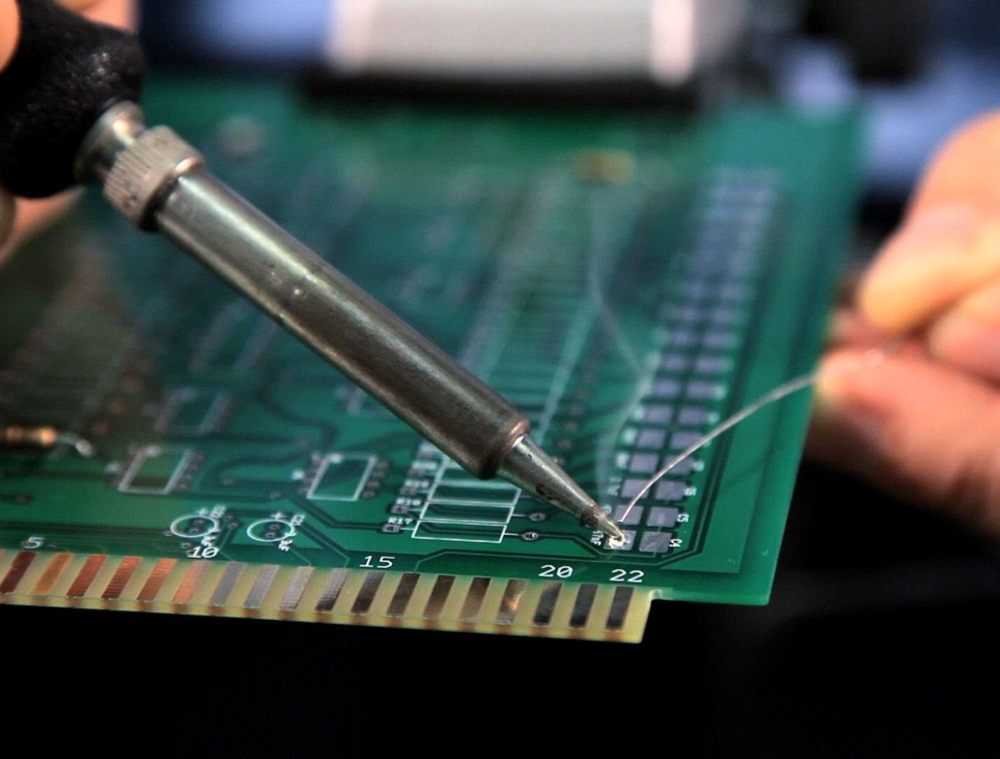
soldering
Be very cautious
300º F to 900º F!
Melt and Fuse Metal
Assume entire rod is hot!
Assume it is always on

Slide 8
Breadboards
Power and ground rows
Columns are connected
Two sides – Gap separated
Grid Layout
Can you Find C:19?

Slide 9

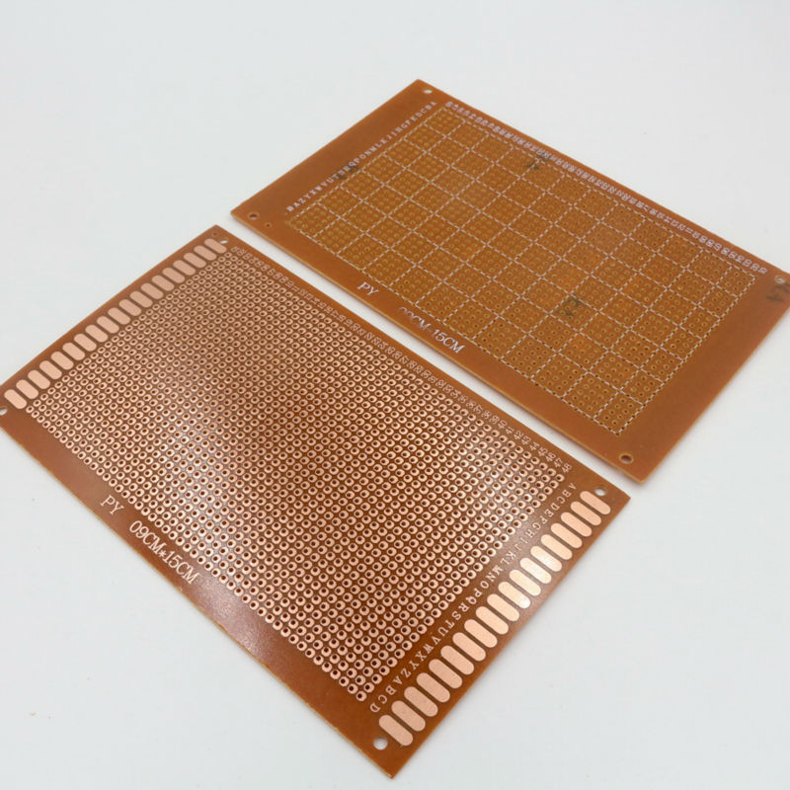
Printed Circuit Boards (PCB)
Similar to breadboard grid layout
Columns are NOT connected
Prototyping
Solder to copper pads

Slide 10
Parts List
Altoids Tin
51K resistor
Photoresistor
DC jack
NodeMCU
BMP280 + Header
3 Female Headers (1 4-pin, 2 15-pin)
5x7 PCB
8 Standoffs
9V Battery Plug
9V Wall Plug

Slide 11
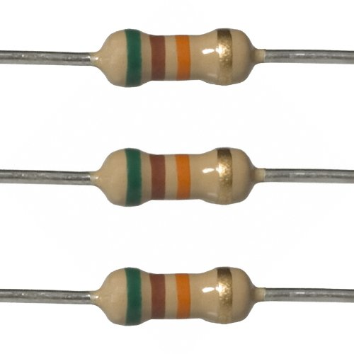
Resistors
Restrict current
Give off heat
Color bands indicate resistance

Slide 12
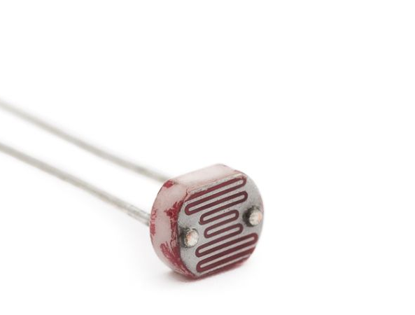
PhotoResistors
Change resistance based on light intensity
Voltage division

Slide 13

Voltage Division
V_{out} = (R₂ ÷ (R₁ + R₂)) * V_{in}

Slide 14
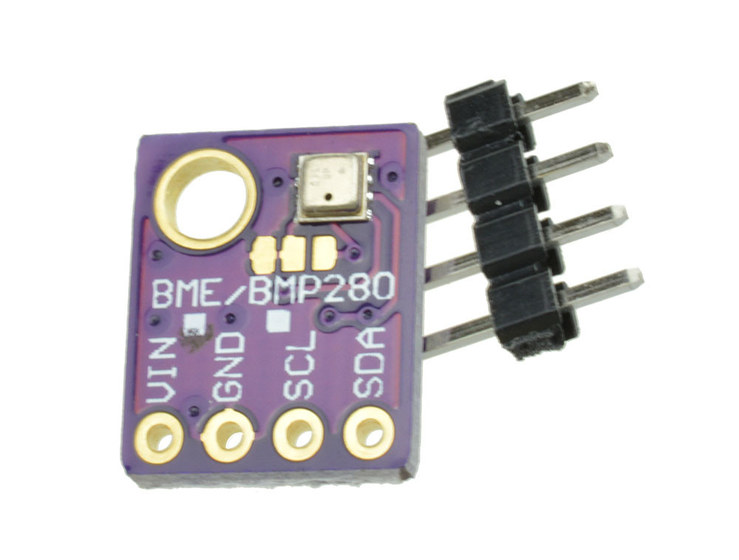
BMP280 Sensor
Vin – 1.8V – 5V
SCL/SDA – i²c or SPI
Temperature
Humidity
Barometric Pressure

Slide 15
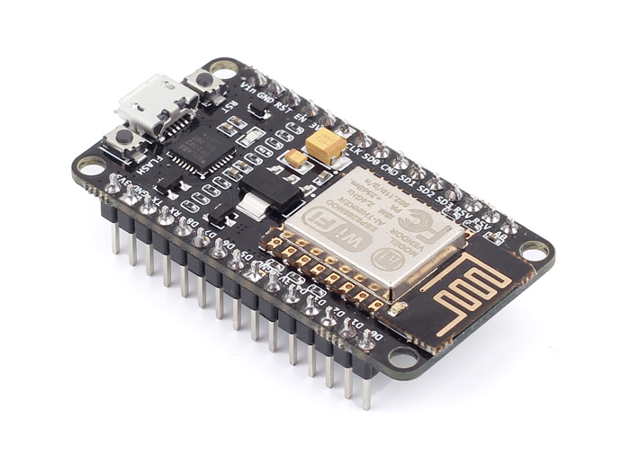
NodeMCU
ESP8266 - ESP-12E
Version 2
Lua Programming Language
3.3V Based
1 Analog Pin
GPIO and PWMs
Input Voltage 5-10V

Slide 16
IDE for NodeMCU
Click ESPlorer icon on the desktop

Slide 17
Flashing Firmware
esptool.py

Slide 18
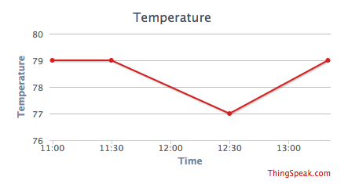
Thingspeak
IoT Analytics
Collect and View Data
Free for our usage

Slide 19

Create thingspeak account
https://thingspeak.com/
Sign Up
Create Account
Create Test Channel
Add single field called ’sample’

Slide 20
Test MCU
Open mcu_test.lua on desktop under diyweather folder
Change the API key for thinkspeak to your API key
Connect the NodeMCU via USB
Select the Port
Click Open
Click ‘RST’ on the NodeMCU
Click on ‘Save to ESP’

Slide 21
Next session
January 19th – 5-6:30 pm
Please bring a USB cable for the NodeMCU if you have one
Schematics and Wiring

